Slide 1
Probing Further into “Interpretability”: Caveats & Challenges

Slide 2
Agenda
Two Papers:
Transparency: Motivations and Challenges
The Mythos of Model Interpretability
Break out groups
Discussion

Slide 3
The Mythos of Model Interpretability
Zachary Lipton; 2017

Slide 4
Contributions
Goal: Refine the discourse on interpretability
Outline desiderata of interpretability research
Motivations for interpretability are often diverse and discordant
Identifying model properties and techniques thought to confer interpretability

Slide 5
Motivation
We want models to be not only good w.r.t. predictive capabilities, but also interpretable
Interpretation is underspecified
Lack of a formal technical meaning
Papers provide diverse and non-overlapping motivations for interpretability

Slide 6
Prior Work: Motivations for Interpretability
Interpretability promotes trust
But what is trust?
Is it faith in model performance?
If so, why are accuracy and other standard performance evaluation techniques inadequate?

Slide 7
When is interpretability needed?
Simplified optimization objectives fail to capture complex real life goals.
Algorithm for hiring decisions – productivity and ethics
Ethics is hard to formulate
Training data is not representative of deployment environment
Interpretability serves those objectives that we deem important
but struggle to model formally!

Slide 8
Desiderata
Understanding motivations for interpretability through the lens of prior literature
Trust
Causality
Informativeness
Fair and Ethical Decision Making

Slide 9
Desiderata: Trust
Is trust simply confidence that the model will perform well?
A person might feel at ease with a well understood model, even if this understanding has no purpose
Training and deployment objectives diverge
E.g., model makes accurate predictions but not validated for racial biases
Trust → relinquish control
For which examples is the model right?

Slide 10
Desiderata: Causality
Researchers hope to infer properties (beyond correlational associations) from interpretations/explanations
Regression reveals strong association between smoking and lung cancer
However, task of inferring causal relationships from observational data is a field in itself
Don Rubin
Judea Pearl

Slide 11
Desiderata: Transferability
Humans exhibit richer capacity to generalize, transferring learned skills to unfamiliar situations
Model’s generalization error: gap between performance on training and test data
We already use ML in non-stationary environments
Environment might even be adversarial
Changing pixels in an image tactically could throw off models but not humans
Predictive models can often be gamed
In such cases, predictive power loses meaning
Notes:
Number of accounts → pay a debt or not

Slide 12
Desiderata: Informativeness
Predictions → Decisions
Convey additional information to human decision makers
Example: Which conference should I target?
A one word answer is not very meaningful
Interpretation might be meaningful even if it does not shed light on model’s inner workings
Similar cases for a doctor in support of a decision

Slide 13
Desiderata: Fair & Ethical Decision Making
ML is being deployed in critical settings
Eg., healthcare
How can we be sure algorithms do not discriminate on the basis of race?
AUC is not good enough
Side note: European Union – Right to explanation

Slide 14
Properties of Interpretable Models
Transparency
How exactly does the model work?
Details about its inner workings, parameters etc.
Post-hoc explanations:
What else can the model tell me?
Eg., visualizations of learned model, explaining by example

Slide 15
Transparency: Simulatability
Can a person contemplate the entire model at once?
Need a very simple model
A human should be able to take input data and model parameters and calculate prediction

Slide 16
Transparency: Decomposability
Understanding each input, parameter, calculation
E.g., decision trees, linear regression
Inputs must be interpretable
Models with highly engineered or anonymous features are not decomposable

Slide 17
Algorithmic Transparency
Learning algorithm itself is transparent
E.g., linear models (error surface, unique solution)
Modern deep learning methods lack this kind of transparency
We don’t understand how the optimization methods work
No guarantees of working on new problems
Note: Humans do not exhibit any of these forms of transparency

Slide 18
Post-hoc: Text Explanations
Humans often justify decisions verbally (post-hoc)
Krening et. al.:
One model is a reinforcement learner
Another model maps models states onto verbal explanations
Explanations are trained to maximize likelihood of ground truth explanations from human players
So, explanations do not faithfully describe agent decisions, but rather human intuition

Slide 19
Post-hoc: Visualization
Visualize high-dimensional data with t-SNE
2D visualizations in which nearby data points appear close
Perturb input data to enhance activations of certain nodes in neural nets (image classification)
Helps understand which nodes corresponds to what aspects of the image
Eg., certain nodes might correspond to dog faces

Slide 20
Post-hoc: Example Explanations
Reasoning with examples
E.g., Patient A has a tumor because he is similar to these k other data points with tumors
k neighbors can be computed by using some distance metric on learned representations
Eg., word2vec

Slide 21
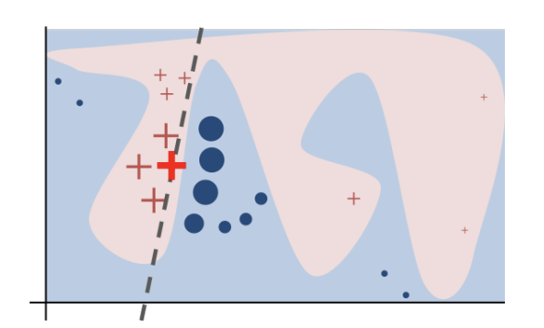
Post-hoc: Local Explanations
Hard to explain a complex model in its entirety
How about explaining smaller regions?
Explains decisions of any model in a local region around a particular point
Learns sparse linear model
LIME (Ribeiro et. al.)

Slide 22
Claims about interpretability must be qualified
If a model satisfies a form of transparency, highlight that clearly
For post-hoc interpretability, fix a clear objective and demonstrate evidence

Slide 23
Transparency may be at odds with broader objectives of AI
Choosing interpretable models over accurate ones to convince decision makers
Short term goal of building trust with doctors might clash with long term goal of improving health care

Slide 24
Post-hoc interpretations can mislead
Do not blindly embrace post-hoc explanations!
Post-hoc explanations can seem plausible but be misleading
They do not claim to open up the black-box;
They only provide plausible explanations for its behavior
E.g., text explanations

Slide 25
Summary
Goal: Refine the discourse on interpretability
Outline desiderata of interpretability research
Motivations for interpretability are often diverse and discordant
Identifying model properties and techniques thought to confer interpretability

Slide 26
Transparency: Challenges and Motivation
Adrian Weller; 2019

Slide 27
Contributions
Characterizing different kinds of transparency, and underlying motivations
Shedding light on the downsides of having transparency

Slide 28
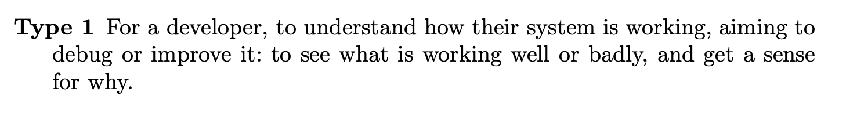
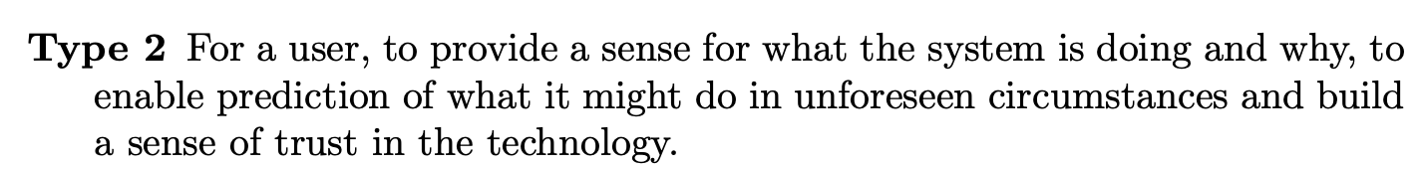
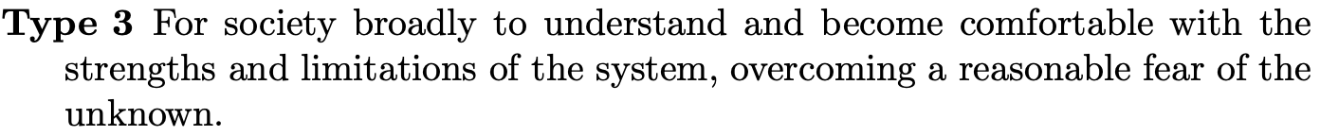
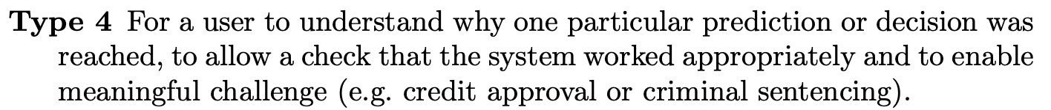
Types and Goals of Transparency

Slide 29
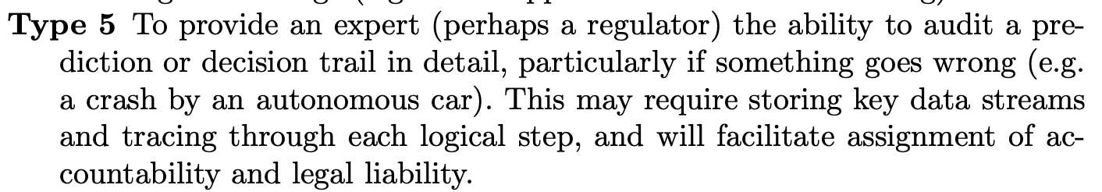
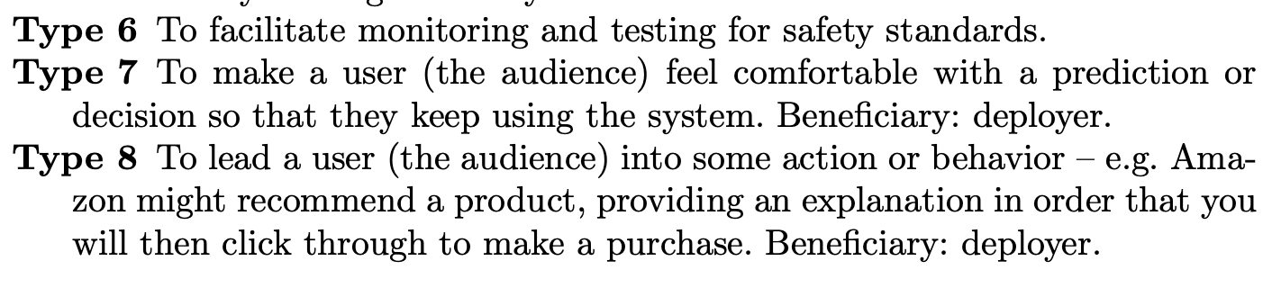
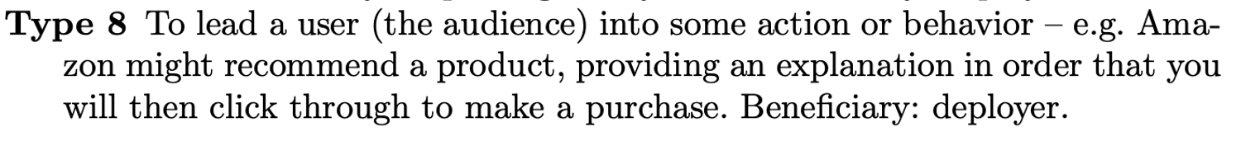
Types and Goals of Transparency

Slide 30
Global vs. Local
Global: understanding whole system
Types 2 – 3
Local: explanation for a particular prediction
Types 4, 5, 7, 8

Slide 31
Types and Goals of Transparency
Explanations are beneficial to the society only if they are faithful
Notion of faithfulness is hard to characterize precisely!
Defining criteria and tests for practical faithfulness are important open problems
Context is important!

Slide 32
Types and Goals of Transparency
Another challenge: Is an explanation good at conveying faithful information in understandable form, and if a human has actually understood it well?
Context dependent
Need for deeper probing!

Slide 33
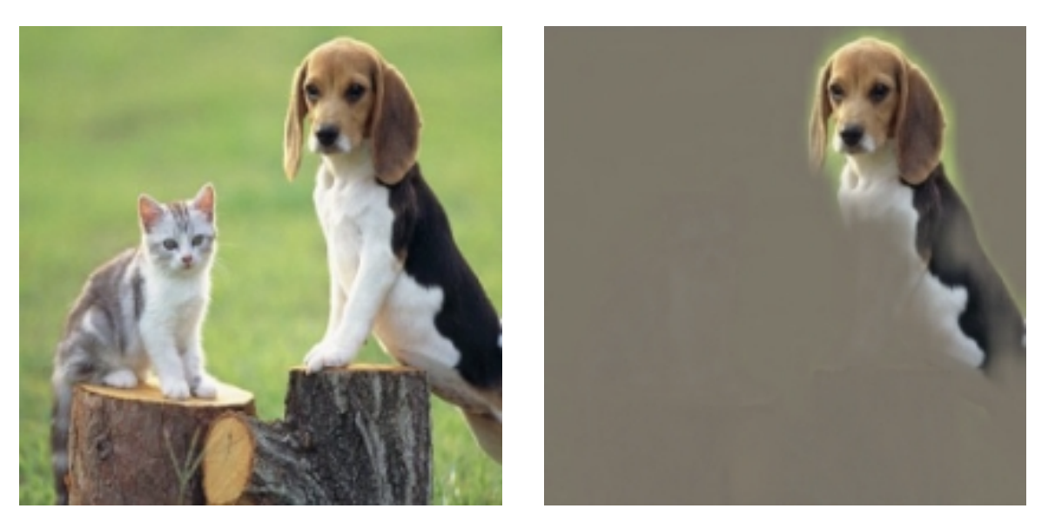
Comparing explanations is also hard!
If we have two different saliency maps, how to know which one is better?

Slide 34
Possible Dangers: Audience vs. Beneficiary
Recommender systems
Amazon (Beneficiary) and its Users (Audience)
Healthcare
Google Verily (Beneficiary) and Hospitals/Doctors (Audience)
Criminal Justice
COMPAS (Beneficiary) and Courts/Judges (Audience)

Slide 35
Government Use of Algorithms
COMPAS system predicts risk of recidivism
A prisoner should have some transparency into the decision made by COMPAS
To ensure proper process has been followed
Enable potential challenge
But, can there be too much transparency?
Also, recent push for making all code/data for such models public. Good idea?

Slide 36
Gaming, IP Incentives, and Privacy
If all details available, the process can be gamed
Less incentive for private IP and slow progress
Privacy and transparency are often in conflict
How much transparency is too much in a setting?

Slide 37
Means and Ends
Transparency → reliability, fairness
If we are able to develop a good set of “safety checks”, then may be it is ok to not have full transparency
E.g., autonomous vehicles

Slide 38
Does giving more information to each individual help society?
Braess’ paradox: more information empowers the agents to optimize their own agendas more efficiently, and thus may lead to a worse global outcome

Slide 39
Selective Transparency & Discrimination
Selective Transparency may hurt people disproportionately
Furthermore, transparency about certain attributes (e.g., gender) in certain settings is known to cause discriminatory behavior as well

Slide 40
Break Out Groups
Based on the different papers we have covered, can you summarize your stance on:
When/Why is interpretability needed?
When is interpretability a bad idea?
Are there any privacy concerns around making models interpretable? What about fairness concerns?
In real world settings, there have been cases where simpler models were chosen over accurate ones to secure “trust” of decision makers. What do you think about this?

